Slide 1


Investigating the Molecular Epidemiology of Carbapenem-Resistant Klebsiella pneumoniae (CR-KP) in Patients with Acute Myeloid Leukemia (AML)
Presented by: AMR Warriors

Slide 2





Allou Frederick
(Bioinformatician & Project Lead)
Ayinla Akeemat
(Microbiologist & Systematic Reviewer)
Ayegbusi Olaitan
(Epidemiologist & Database Researcher)
Yetunde M. Alo
(Oncologist & Data Analyst)

Slide 3
Background
Carbapenem-resistant Klebsiella pneumoniae (CR-KP) poses a significant public health threat, especially in immunocompromised populations such as patients with Acute Myeloid Leukemia (AML) (Asai et al., 2018).
There is limited data specific to AMR epidemiology in AML patients.
Understanding the genomic epidemiology of CR-KP in this population can inform treatment strategies and infection control measures.

Slide 4
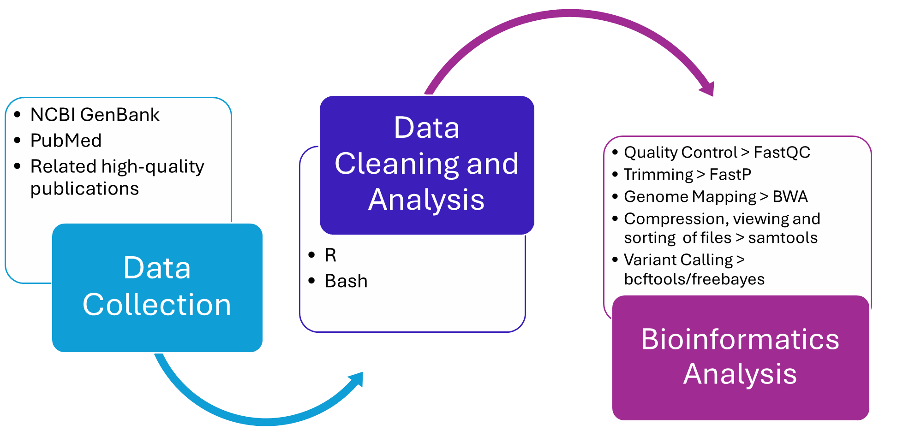
Methods

Slide 5
Expected Outcomes
Determination of the prevalence of CR-KP in AML patients.
Identification of prevalent resistance mechanisms and clonal lineages of Klebsiella pneumoniae.
Characterization of the genomic diversity of CR-KP in AML patients.
Identification of risk factors associated with CR-KP infections.

Slide 6

Thank you for your time. Questions are welcome.

